Slide 1
Saint Patrick’s Day

Slide 2
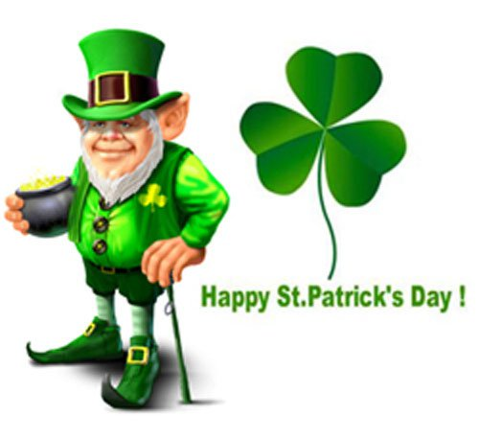

Slide 3
17th March
Every year on the seventeenth of March, people around the world celebrate St Patrick’s Day.
It’s the death date of the patron saint of Ireland, Saint Patrick.

Slide 4
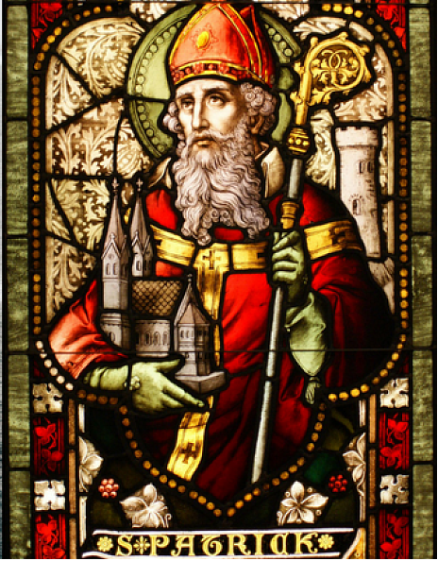

Slide 5
He was a missionary who brought Christianity to the Irish people.
There are many legends about him.
One of them says that Saint Patrick used a shamrock to explain the mystery of the Holy Trinity to the Irish pagans.
Today, the green shamrock is the symbol of Ireland and many people wear something green on St Patrick’s Day.

Slide 6
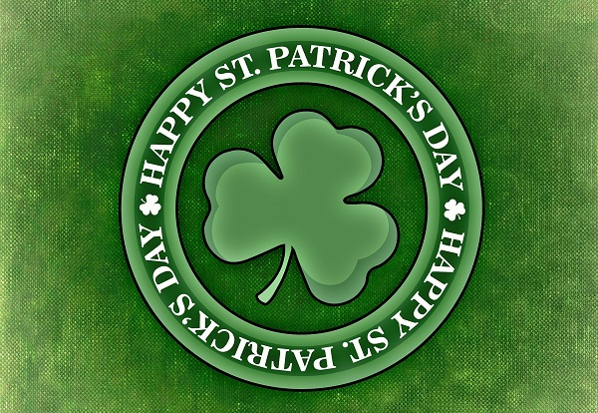
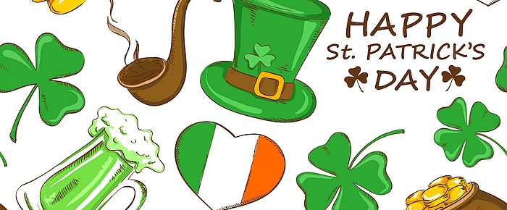

Slide 7
In Dublin, the capital of Ireland , there is five-day St Patrick’s Day Festival. There are wonderful parades, performances and dances.
The first parade was not in Dublin, but in New York, it started in 1762. The celebrations are now held in many different countries around the world and everyone who is Irish at heart can join the fun.

Slide 8
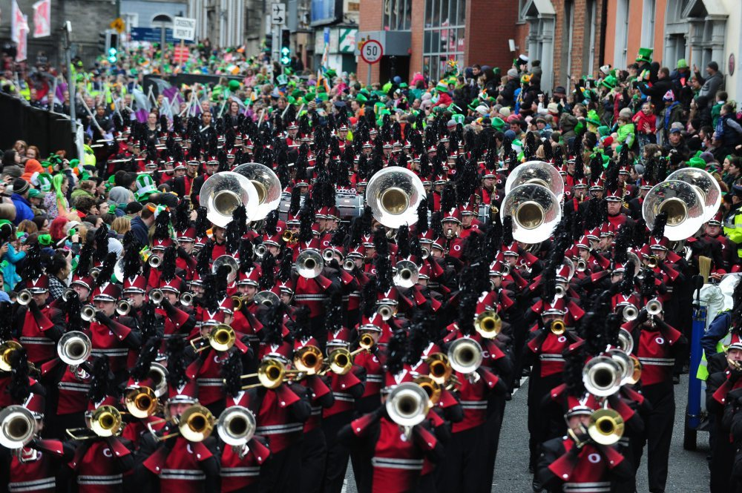
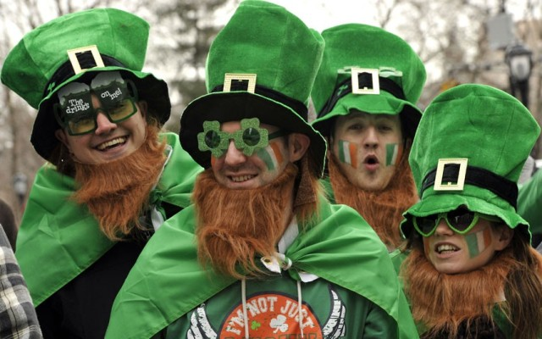
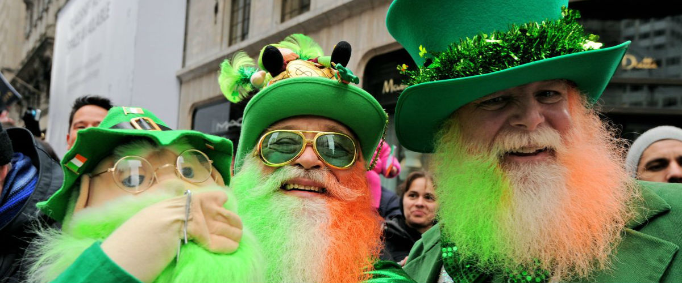
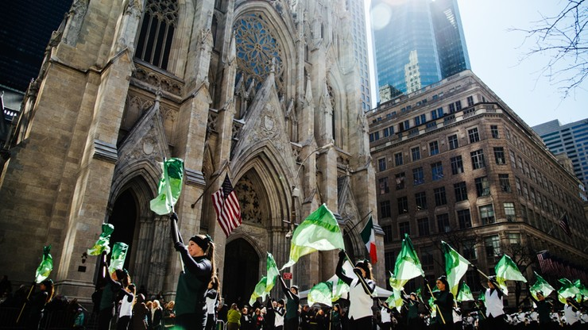

Slide 9
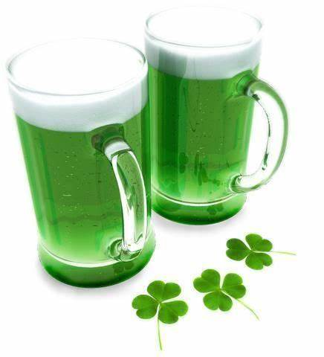
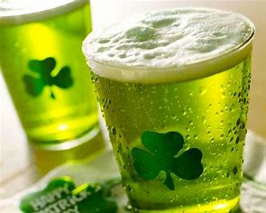
On St. Patrick's Day you can have a green beer.

Slide 10
Another tradition related to the celebration of St. Patrick's Day is the tradition of drinking whiskey - the obligatory glass of whiskey is called "Patrick's pitcher". Behind this tradition there is a legend according to which Saint Patrick frightened a certain innkeeper who did not fill a full measure of alcohol. Saint Patrick said that monsters would appear in her inn. The scared woman always filled her glasses since then.

Slide 11
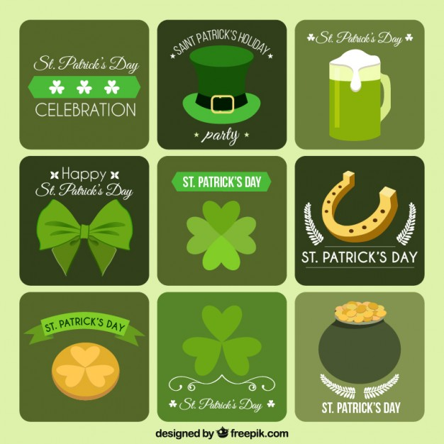
The symbols of St Patrick’s Day

Slide 12
Thanks for watching ☺

Slide 13
Bibliography
dzien swietego patryka brain.ly - Bing images
Dzień Świętego Patryka – Wikipedia, wolna encyklopedia
parada na sw patryka - Bing images

